Slide 1
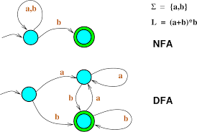
Non Deterministic Finite Automation
---- Sakshi Surve

Slide 2
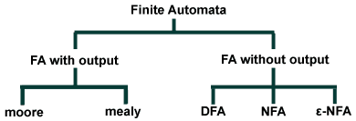

Slide 3
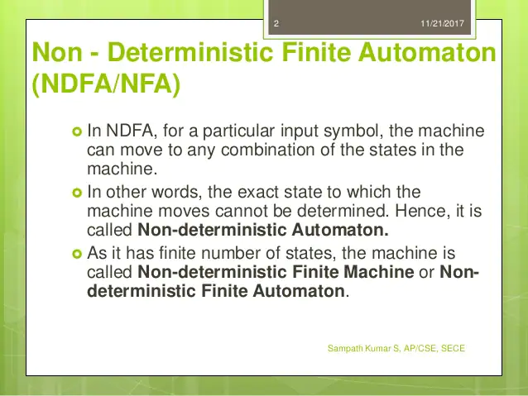

Slide 4
NFA :
A Finite Automaton model which allows zero or one or more transitions from a state on the same input symbol is called as Non- Deterministic Finite Automaton
DFA is a special case of NFA where from each state, there is a unique transition over each input symbol

Slide 5
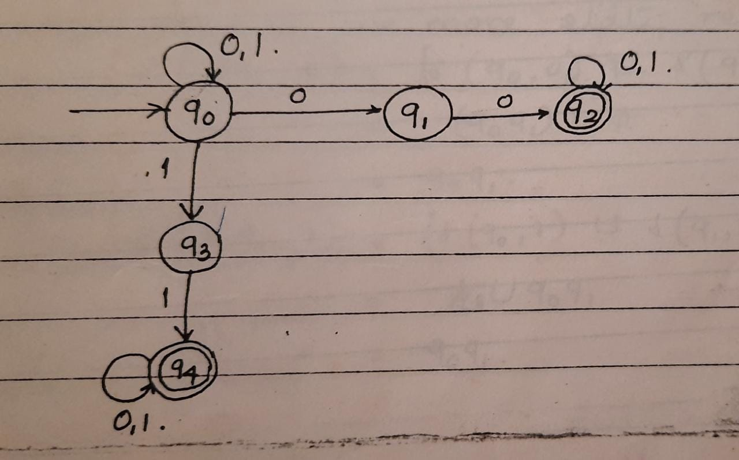
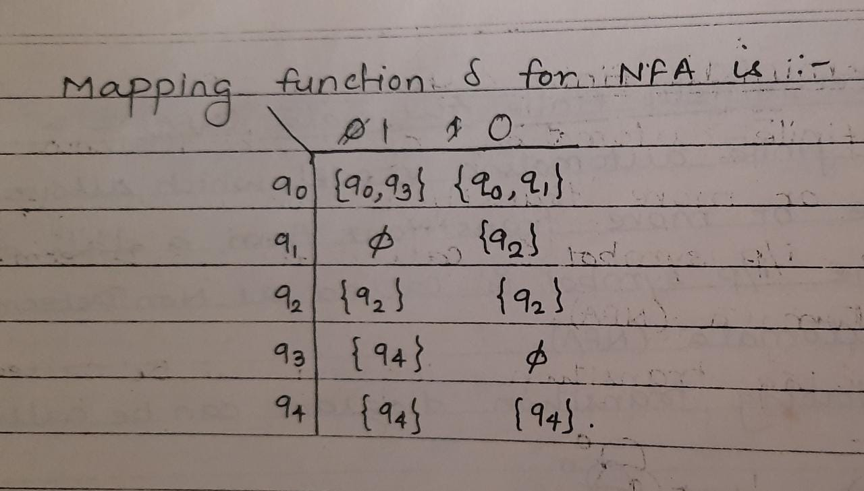
Design a NFA for accepting all binary strings with either two consecutive zeroes or two consecutive 1’s

Slide 6
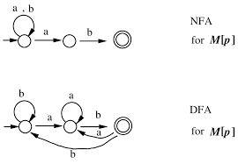
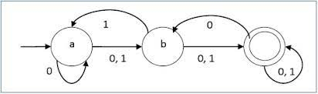

Slide 7
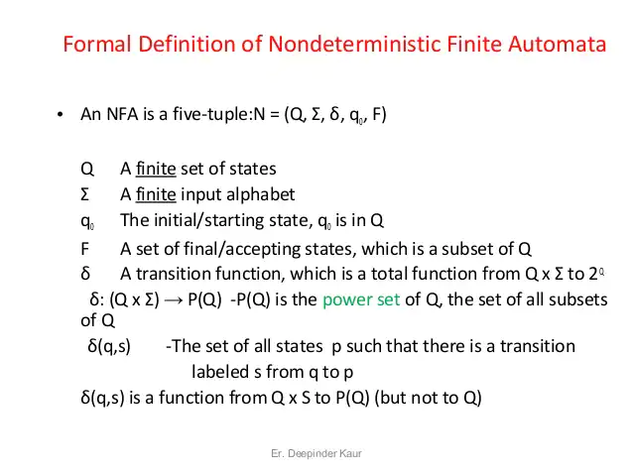

Slide 8
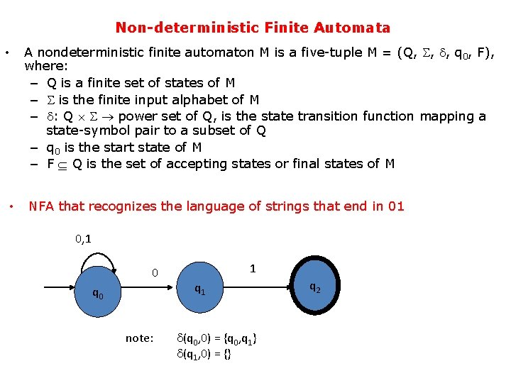

Slide 9
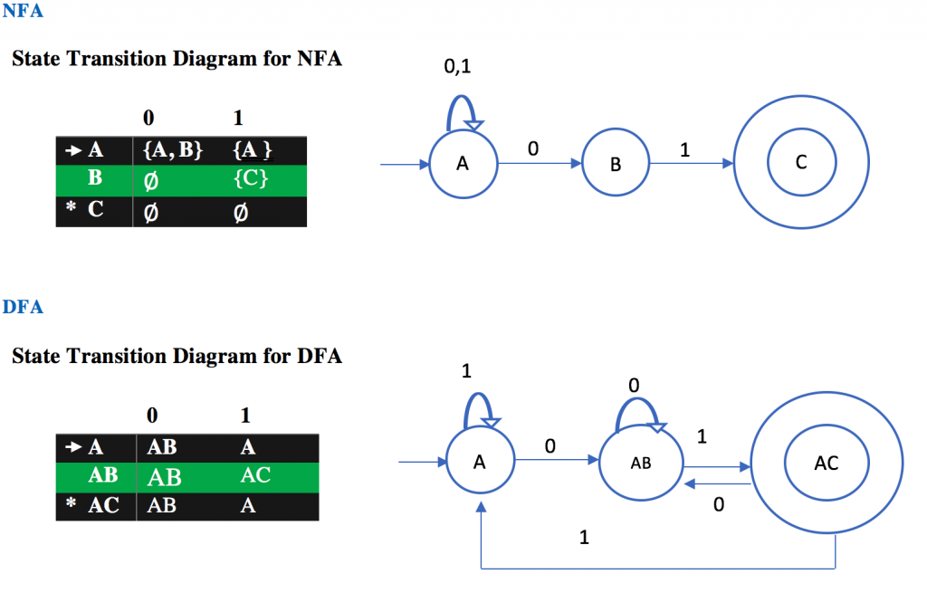

Slide 10
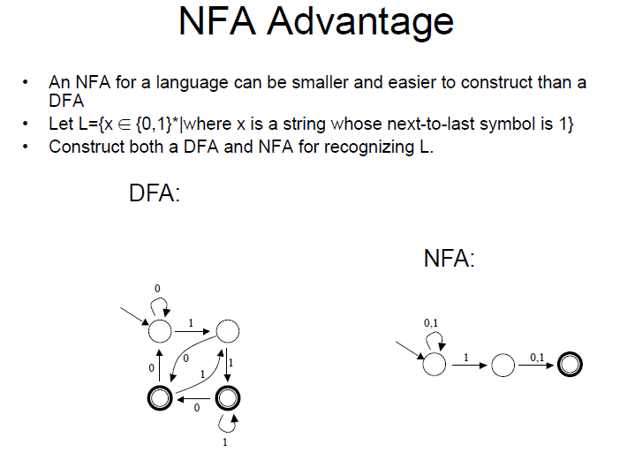

Slide 11
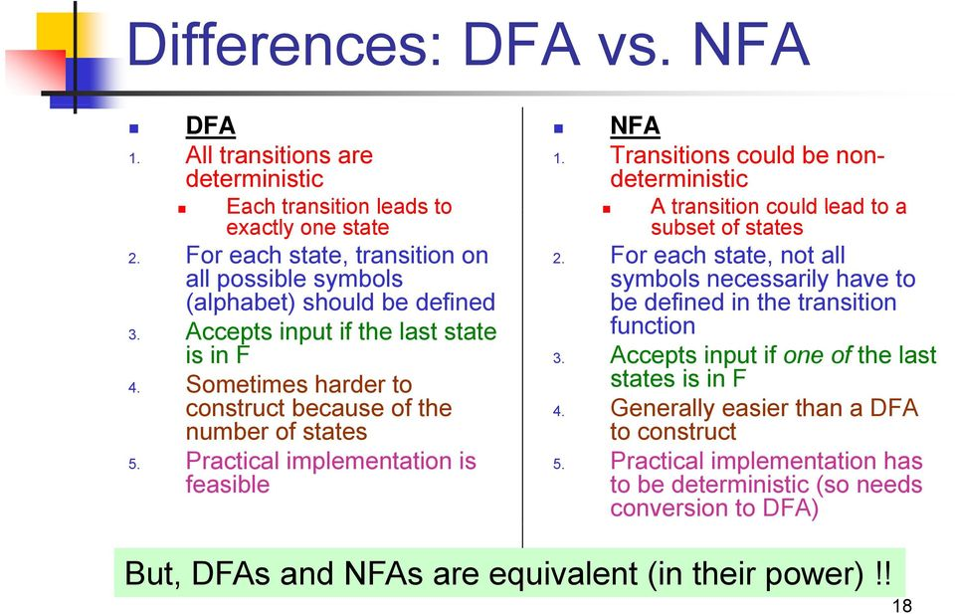

Slide 12
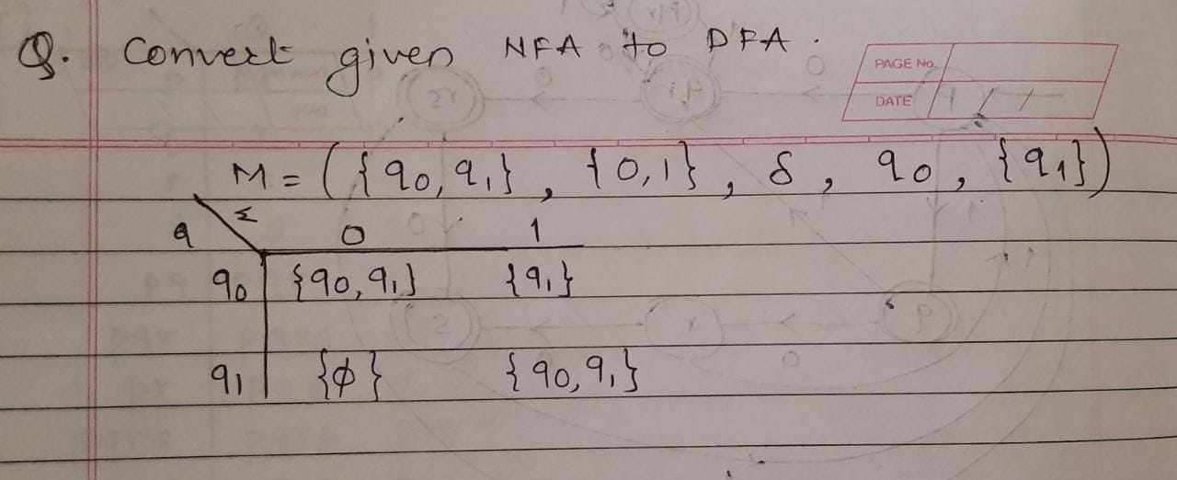
NFA to DFA Conversion :

Slide 13
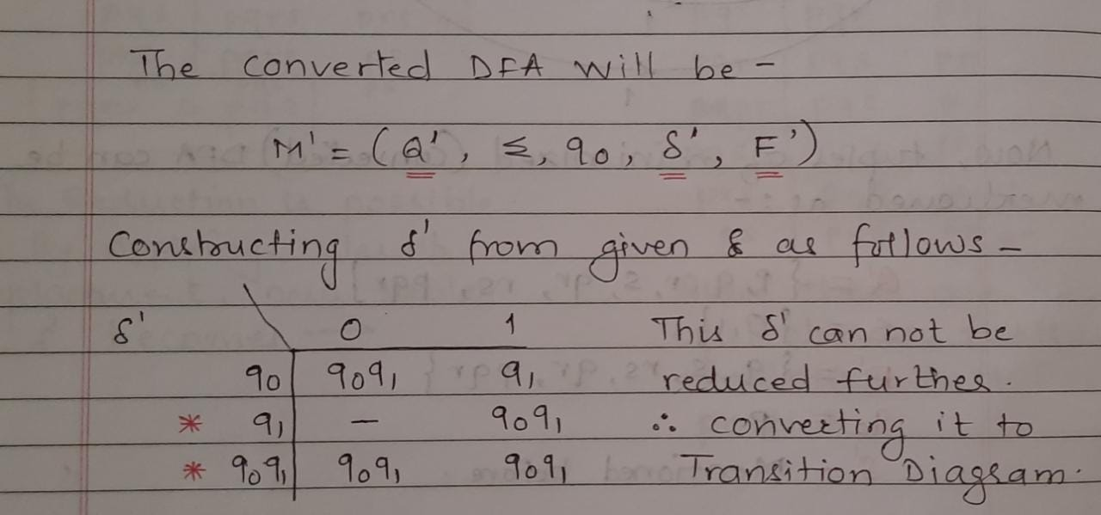

Slide 14
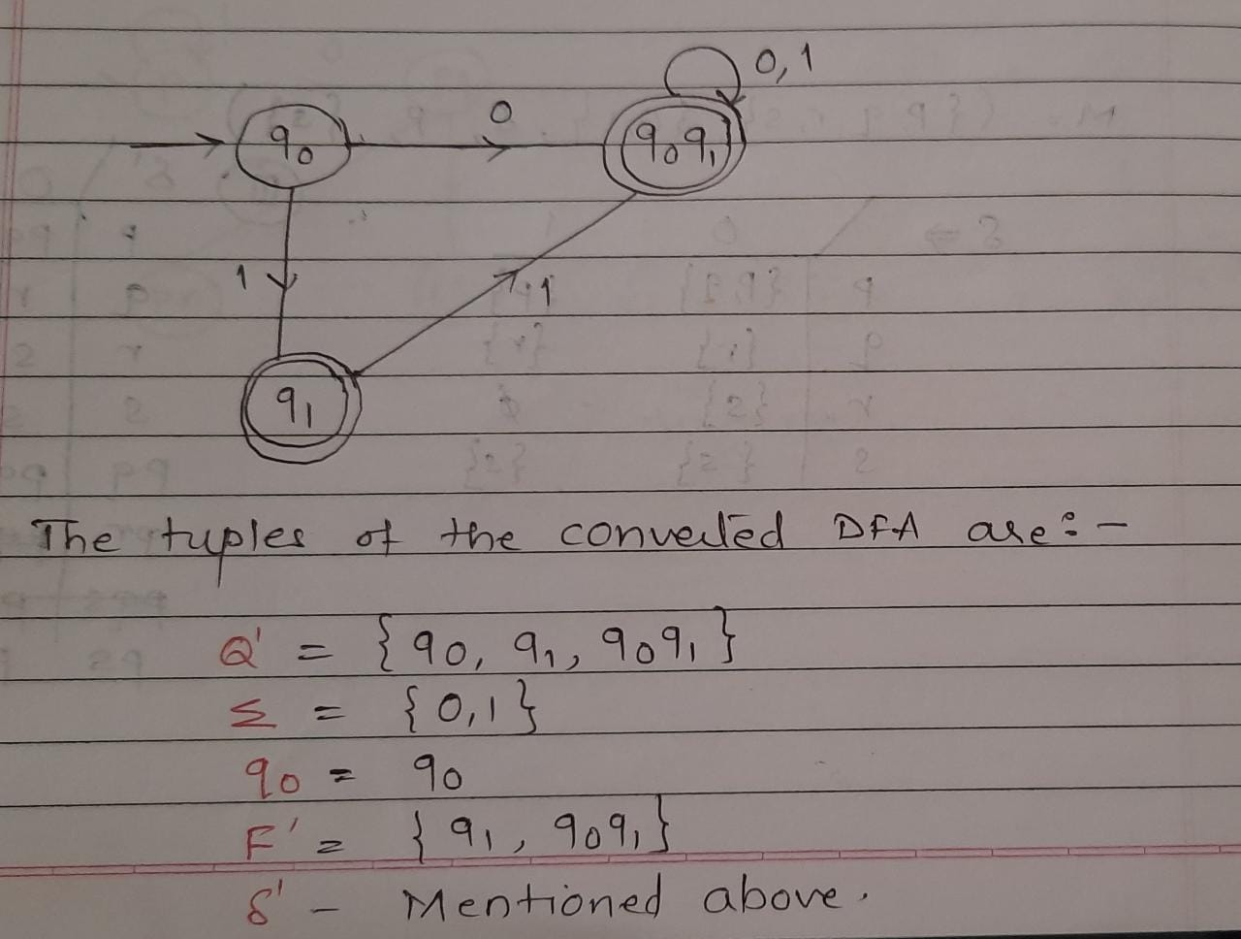

Slide 15
Rules Of Replacement :
A Non Final state can be replaced by it’s equivalent Non Final state only
A Final state can be replaced by another Final state only
The Initial state can not be replaced by any other state
Replacing state ‘A’ by ‘B’ means deleting entries related to ‘A’ and whenever we find symbol ‘A’ in the Transition Mapping Function, replace it with ‘B’

Slide 16
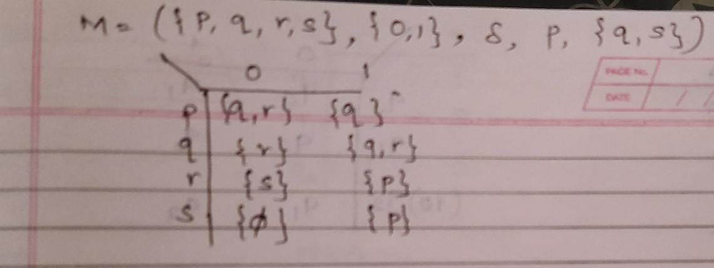
Convert the following NFA to DFA

Slide 17
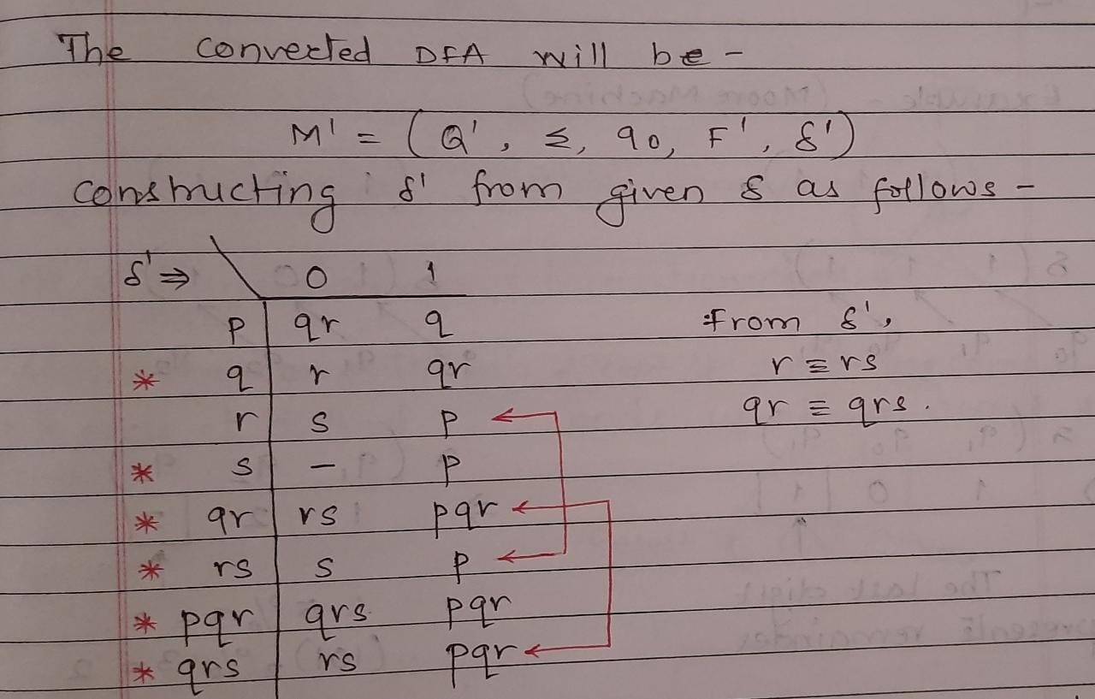

Slide 18
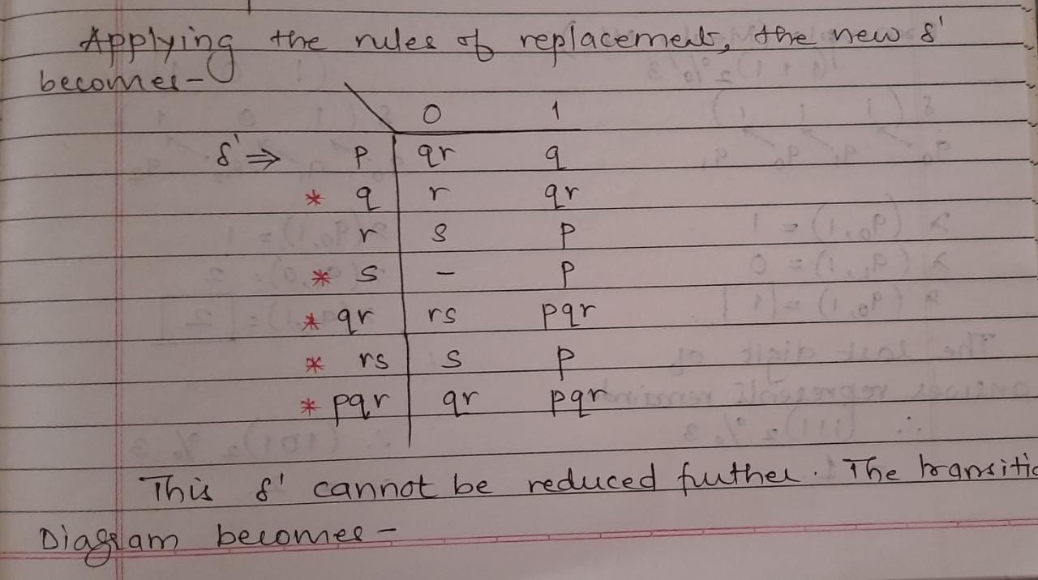

Slide 19
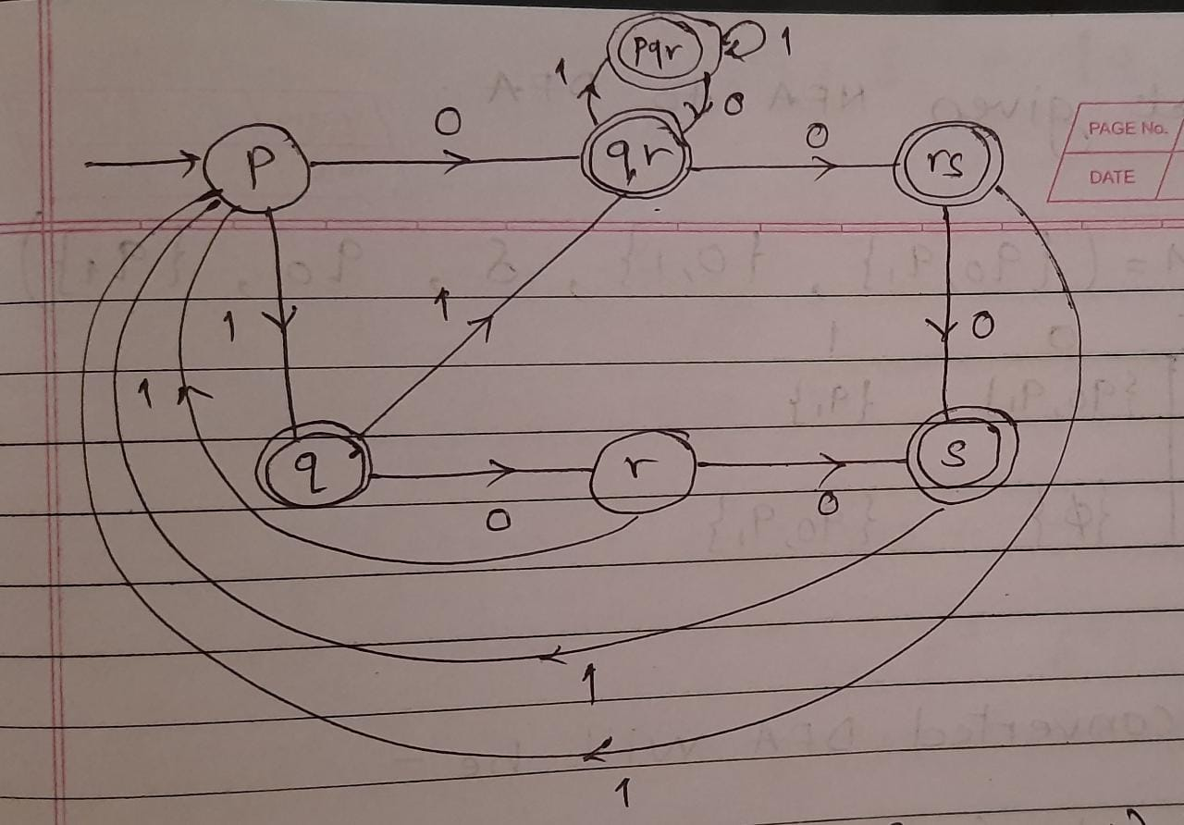

Slide 20
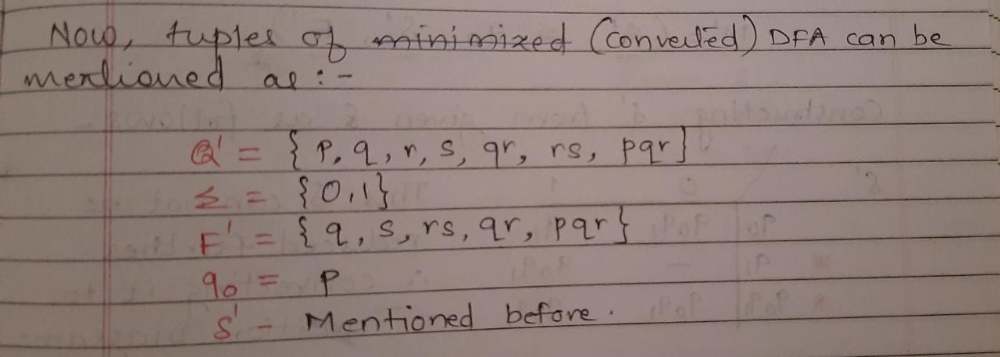

Slide 21
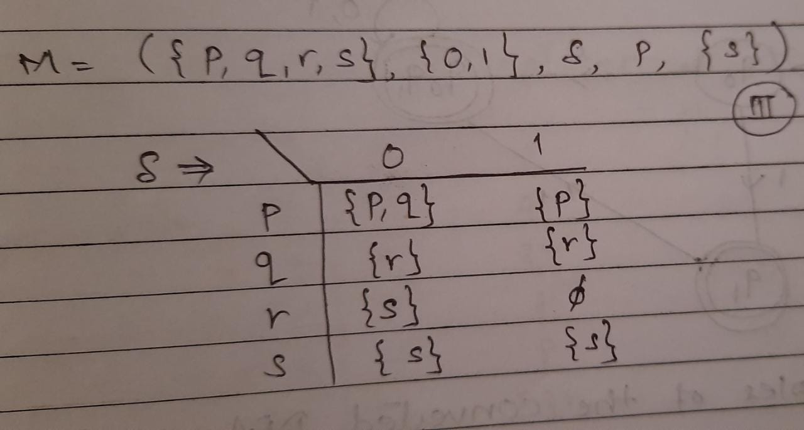
Homework
Convert the given NFA to DFA

Slide 22
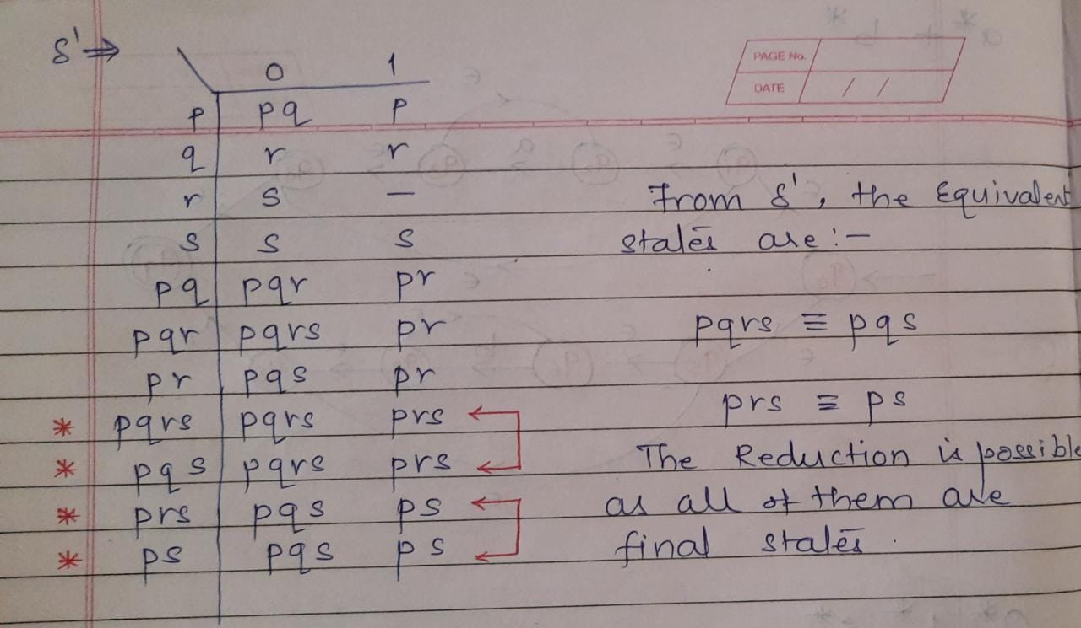

Slide 23
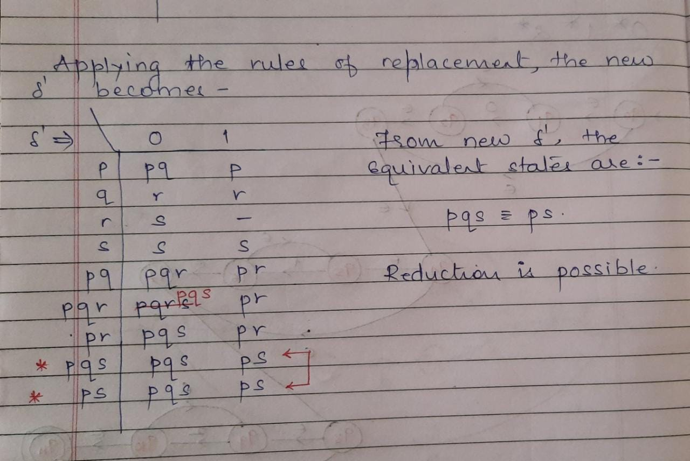

Slide 24
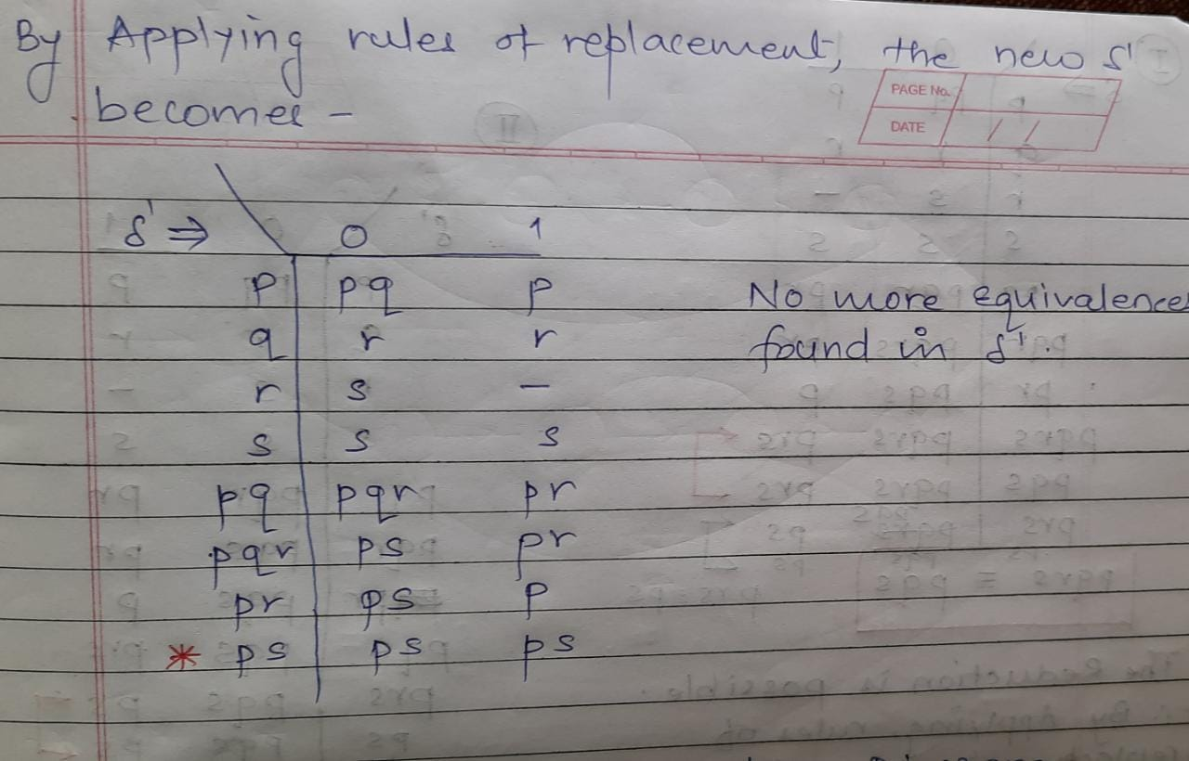

Slide 25
